Slide 1


CHAITANYA BHARATHI INSITUTE OF TECHNOLOGY INTERNSHIP ON INSTAGRAM BOT TEAM-16
BY:
ANSH PARMAR-160120747025-AI&DS
BANDARI SAI KISHORE-160120733044-CSE1
MADIREDDY SAI SIDDARTH REDDY-160120748034-AI&ML
BOORA ANUSHA-160120733306-CSE1
NAGESHWARI GODARI-160120747303-AI&DS
KHUSHI GANGJI-160120732065-CIVIL-A2
SNIGDHA PEDDI-160120747017-AI&DS

Slide 2
CONTENTS
ABSTRACT
INTRODUCTION
SOFTWARE REQUIREMENTS
HARDWARE REQUIREMENTS
IMPLEMENTATION OF PROJECT
CONCLUSION
BIBLIOGRAPHY

Slide 3
ABSTRACT
Instagram is one of the most popular social media among internet users in India. In its development Instagram utilized by the online business as a tool to promote its products to online market. In order to be an effective tools of online marketing, the Instagram account used should have many followers. In addition, the number of followers can be used as a reference to determine the advertising rate or widely known as endorsement. Instagram bot is basically a bot which automates all the activity of the user on the platform of Instagram.it collectively gathers information about the user and help us build a smooth platform for the user. All the functions of our Instagram bot are chatting with people, following and liking the post of other users and an additional feature of auto commenting. This way the user of our application may lead his/her personal life & his social life satisfactorily.

Slide 4
INTRODUCTION
In our Modern day world advert of internet facilities increasing population has led to a significant global increase in social media platform. Instagram Being a wide range social media platform at the present time to help the people have a balance between social and personal life. So because of this reason Instagram bot has been created. Instagram bots are first introduced in the year 2017,these days it is widely used for the advertisement or promotion of a company or a brand. This way in the less time span the company growth or reach to the people can be much easier and takes very less time.

Slide 5
MOTIVATION
In our Modern day world advert of internet facilities increasing population has led to a significant global increase in social media platform. Instagram Being a wide range social media platform at the present time to help the people have a balance between social and personal life. So because of this reason Instagram bot has been created.
The main motivation of the project is to decrease the screen time of the people and to use Instagram messaging feature at will. without actually using the app or the web version of it.

Slide 6
SOFTWARE REQUIREMENTS
OS required Microsoft DOS , Microsoft windows 7
OS family windows
Python 3.8 for compiling and executing

Slide 7
HARDWARE REQUIREMENTS
Min ram 4mb
Min Hard Drive space 25mb
Min processor type intel 386 or higher

Slide 8
IMPLEMENTATION OF PROJECT
SOURCE CODE:
Modules used: selenium:It is a open source tool that automates web browsers, it provides a single interface that let’s you write test scripts in programming languages like ruby, java, python, php, perl, node-js. A browser driver then executes these scripts on a browser instance(Here we are using chrome driver 92.0.4515.107).To install these module run the command in terminal as “pip install selenium”.
from selenium import webdriver
from selenium.webdriver.common.keys import Keys
import time, random

Slide 9
messages = ['avail 10% off on ur 1st order', 'wardrobe refreshed everyday', 'use promo code:abc10off']
# Delay time between messages in sec:
between_messages = 5
browser = webdriver.Chrome('chromedriver’)
# in this part of the program we are using the credentials provided in the login part of the program. we are defining a function name “auth” to login into the respective Instagram accounts:

Slide 10
def auth(username, password):
try:
browser.get('https://instagram.com')
time.sleep(random.randrange(2,4))
input_username = browser.find_element_by_name('username')

Slide 11
input_password = browser.find_element_by_name('password')
input_username.send_keys(username)
time.sleep(random.randrange(1,2))
input_password.send_keys(password)
time.sleep(random.randrange(1,2))

Slide 12
input_password.send_keys(Keys.ENTER)
except Exception as err:
print(err)
browser.quit()
# here we are sending the messages to the customers as a form of advertisement:

Slide 13
def send_message(users, messages):
try: browser.find_element_by_xpath('/html/body/div[1]/section/nav/div[2]/div/div/div[3]/div/div[2]/a').click()
time.sleep(random.randrange(3,5))

Slide 14
browser.find_element_by_xpath('/html/body/div[5]/div/div/div/div[3]/button[2]').click()
for user in users:
time.sleep(random.randrange(1,2)) browser.find_element_by_xpath('/html/body/div[1]/section/div/div[2]/div/div/div[2]/div/div[3]/div/button').click()
for user in users:

Slide 15
time.sleep(random.randrange(1,2)) browser.find_element_by_xpath('/html/body/div[5]/div/div/div[2]/div[1]/div/div[2]/input').send_keys(user)
time.sleep(random.randrange(2,3))
browser.find_element_by_xpath('/html/body/div[5]/div/div/div[2]/div[2]/div[1]').find_element_by_tag_name('button').click()

Slide 16
time.sleep(random.randrange(3,4)) browser.find_element_by_xpath('/html/body/div[5]/div/div/div[1]/div/div[2]/div/button').click()
time.sleep(random.randrange(3,4))
text_area = browser.find_element_by_xpath('/html/body/div[1]/section/div/div[2]/div/div/div[2]/div[2]/div/div[2]/div/div/div[2]/textarea')

Slide 17
text_area.send_keys(random.choice(messages))
time.sleep(random.randrange(2,4))
text_area.send_keys(Keys.ENTER)
print(f'Message successfully sent to {user}')
time.sleep(between_messages) browser.find_element_by_xpath('/html/body/div[1]/section/div/div[2]/div/div/div[1]/div[1]/div/div[3]/button').click()

Slide 18
except Exception as err:
print(err)
browser.quit()
#here for accesing the parameters of the class we are creating an object to call them.
auth(my_username, my_password)
time.sleep(random.randrange(2,4))
send_message(usernames, messages)

Slide 19
#here for accesing the parameters of the class we are creating an object to call them.
auth(my_username, my_password)
time.sleep(random.randrange(2,4))
send_message(usernames, messages)

Slide 20
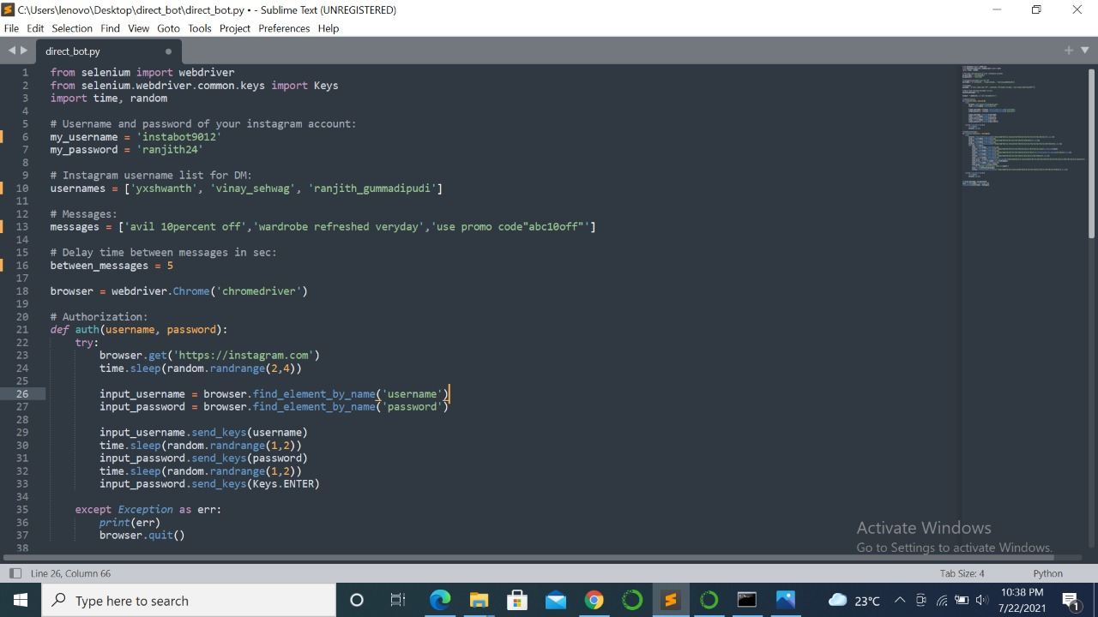

Slide 21
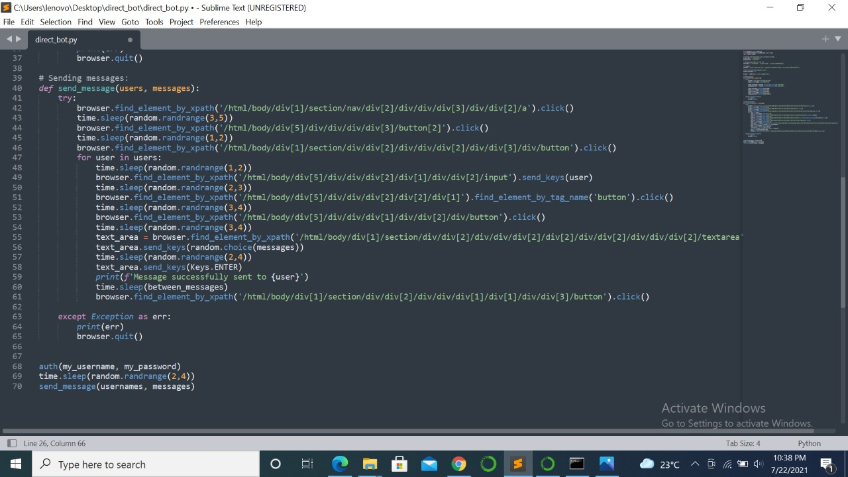

Slide 22
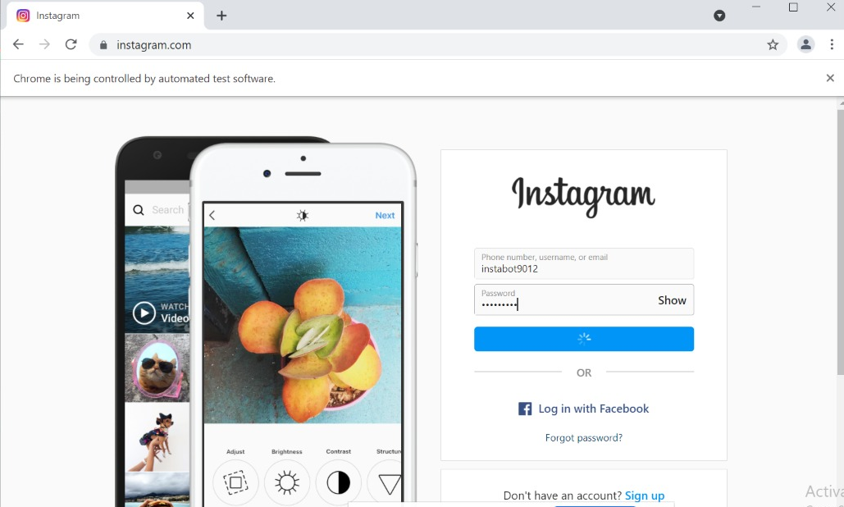

Slide 23
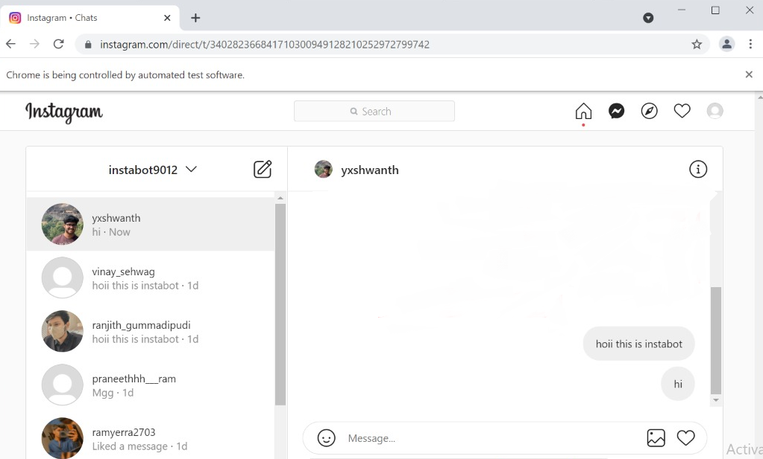

Slide 24
The conclusion
After testing and final validation, it is concluded that the project is successful in carrying out all the functionalities mentioned above in the report. This application will therefore provide a platform for advertisers and influencers in expanding their brand and influence accordingly.

Slide 25
FUTURE SCOPE
More features will be added eventually like mass scaling of advertisement with zero delay in time. It will be more developed using machine learning and artificial intelligence, which automatically suggests the advertisement for the accounts which are interested in the specified fields.

Slide 26
BIBOLOGRAPHY
1)https://www.google.com/url?sa=t&rct=j&q=&esrc=s&source=web&cd=&cad=rja&uact=8&ved=2ahUKEwjPhYS4tvnxAhVRbysKHZGQBC8QFjAAegQIBRAD&url=https%3A%2F%2Frealpython.com%2Finstagram-bot-python-instapy%2F&usg=AOvVaw0UpBDCodF80ATj3ZaZM0qV
2)https://medium.com/analytics-vidhya/making-an-instagram-bot-using-selenium-and-python-ea94f217d0dd
3) https://www.geeksforgeeks.org/instagram-bot-using-python-and-instapy/
4) core.ac.uk/160021722(Indonesia article)
5) https://core.ac.uk/download/pdf/160021722.pdf

Slide 27
THANK YOU

